Slide 1
Machine Learning

Slide 2
Machine Learning Intro
Big Data - ? ? ?
Data Engineering - ? ? ?
Machine Learning - ? ? ?
Deep Learning - ? ? ?
Reinforcement Learning - ? ? ?
AI - ? ? ?
NLP - ???
Better focus on the Business problem at hand.
Learn and use whatever….WHATEVER is necessary

Slide 3
Machine Learning Intro
Some prominent applications:
Identification of unwanted spam messages in e-mail
Segmentation of customer behavior for targeted advertising
Forecasts of weather behavior and long-term climate changes
Reduction of fraudulent credit card transactions
Prediction of popular election outcomes
Development of algorithms for auto-piloting drones and self-driving cars
Optimization of energy use in homes and office buildings
Projection of areas where criminal activity is most likely
Discovery of genetic sequences linked to diseases

Slide 4
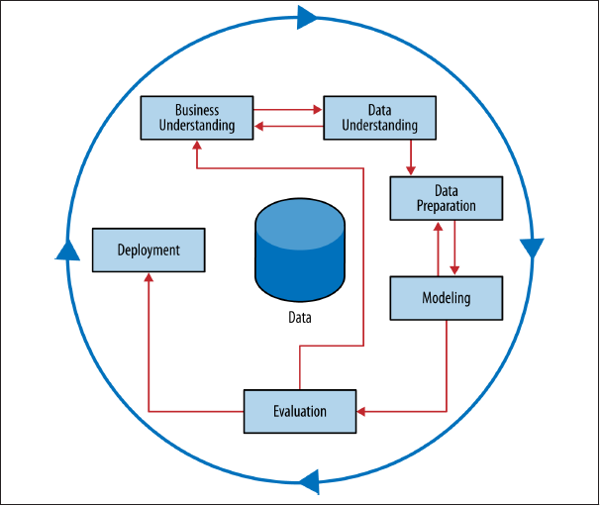
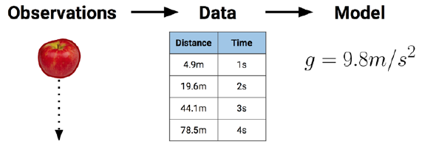
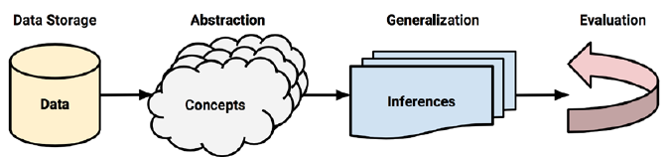
Machine Learning Intro
Supervised Vs Unsupervised – Supervisor / Label / Target/ Predicted variable / Dependent variable
Prediction Vs Description
Black box vs White box
Discrete results Vs Continuous results
Classification Vs Regression

Slide 5
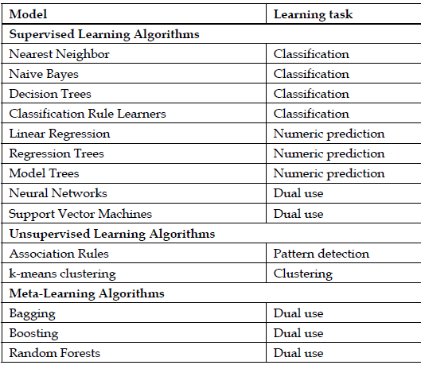
Machine Learning Intro

Slide 6
Machine Learning Intro
A class of machine learning algorithms known as meta-learners is not tied to a specific learning task, but is rather focused on learning how to learn more effectively.
Semi-Supervised Learning - the algorithm is trained upon a combination of labeled and unlabeled data.
Examples : Speech Analysis, Internet Content Classification:
Prescriptive analytics makes use of machine learning to help businesses decide a course of action based on a computer program's predictions. It works with predictive analytics, which uses data to determine near-term outcomes.
Anomaly detection refers to identification of items or events that do not conform to an expected pattern Such anomalies can usually be translated into problems such as structural defects, errors or frauds.
Training data only consists of normal data without any anomalies in Semi-supervised Anomaly Detection

Slide 7
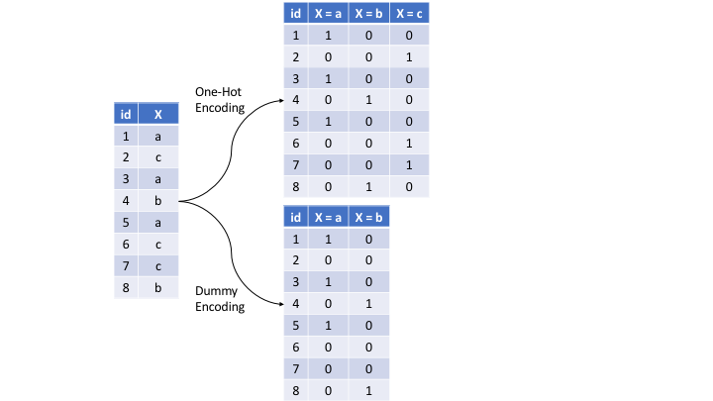
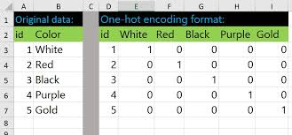
Dummy / One Hot encoding
5 Datasets
X_train
Y_train
X_test
Y_test – hide it
Y_pred – predict it
Optional – validation X and Y
Basic steps in model creation

Slide 8
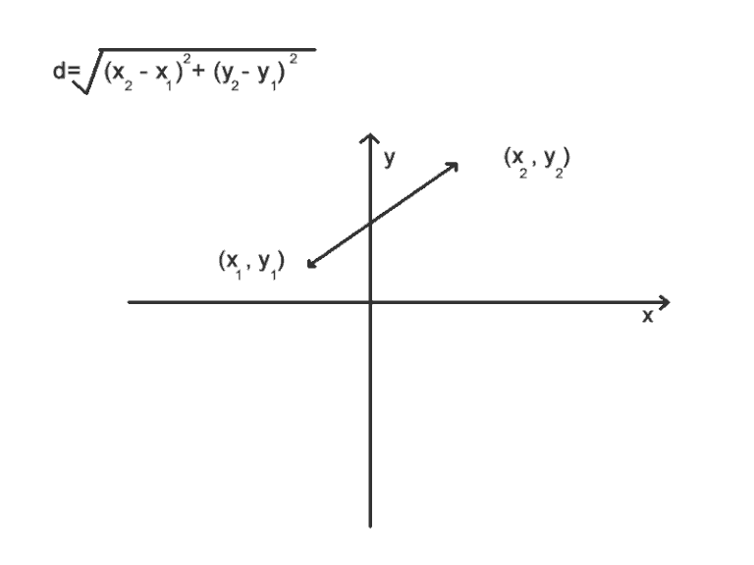
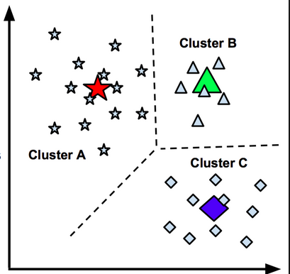
K-Means Clustering
Problem to Solve :
Target different types of clothing to different groups of towns :
Temperature
Humidity
Recursive process
Centroids are chosen at random
Euclidean Distance is computed between each node and centroids
Node is assigned to nearest centroid
Calculate new centroids
REPEAT from step 2
STOP when there is no change in centroids
Temperature
Humidity

Slide 9
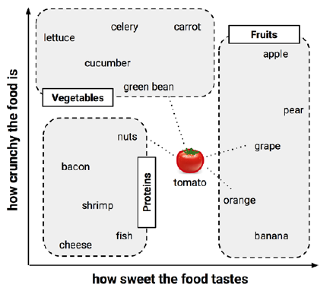
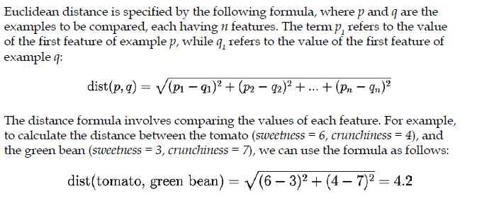
Classification using nearest Neighbors
Basic concepts
Suppose that prior to eating an unknown item we had created a dataset in which we recorded our impressions of a number of items we tasted previously. To keep things simple, we rated only two features of each ingredient.
The k-NN algorithm treats the features as coordinates in a multidimensional feature space.

Slide 10
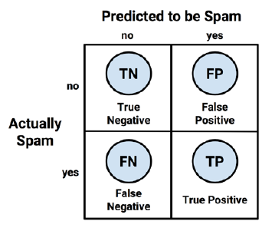
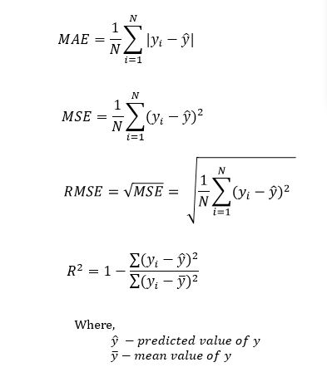




Model evaluation metrics
Regression
Classification
True Positive (TP): Correctly classified as the class of interest
True Negative (TN): Correctly classified as not the class of interest
False Positive (FP): Incorrectly classified as the class of interest
False Negative (FN): Incorrectly classified as not the class of interest

Slide 11

Classification using Naïve Bayes
In statistics and probability theory, Bayes' theorem describes the probability of an event, based on prior knowledge of conditions that might be related to the event. It serves as a way to figure out conditional probability.
This formula helps where finding such a probability is not possible in any other way
Cross checking the formula
Let's suppose we have a Deck of Cards and we wish to find out the probability of the card we picked at random to being a king, given that it is a face card. So, according to Bayes' Theorem, we can solve this problem. First, we need to find out the probability:
P(King) which is 4/52 as there are 4 Kings in a Deck of Cards.
P(Face|King) is equal to 1 as all the Kings are face Cards.
P(Face) is equal to 12/52 as there are 3 Face Cards in a Suit of 13 cards and there are 4 Suits in total.
P(King|Face)=P(Face|King)*P(King)/P(Face) = (1*1/13)/(3/13)=(1/13)*(13/3)=1/3

Slide 12
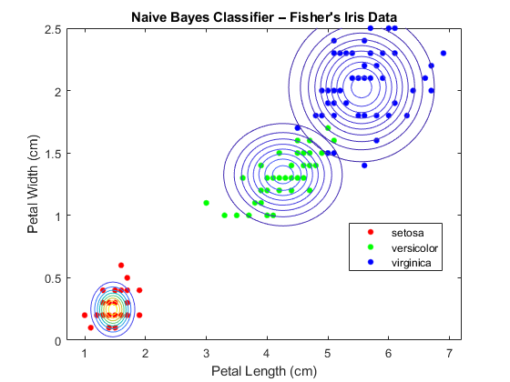
Classification using Naïve Bayes

Slide 13
Classification using Naïve Bayes
What is the probability that an SMS is spam considering that it has the word “lottery”
What is the probability of the word “lottery” coming up in spam SMS?

Slide 14


Classification using Naïve Bayes
P(A) = P(Sports)
P(B) = P(A very close game)
Text | Tag
“A great game” | Sports
“The election was over” | Not sports
“Very clean match” | Sports
“A clean but forgettable game” | Sports
“It was a close election” | Not sports
P(B|A) = P(A very close game|Sports)
What is the probability that “A very close game” may be tagged to Sports?
P(Sports| A very close game)?? = P(A|B)
Using the multiplication rule of probability considering that the events are independent. – The Naïve part

Slide 15
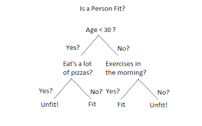
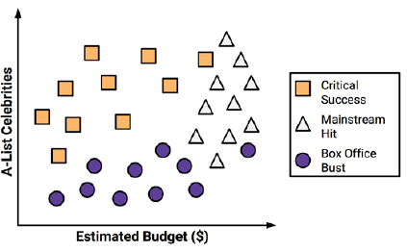
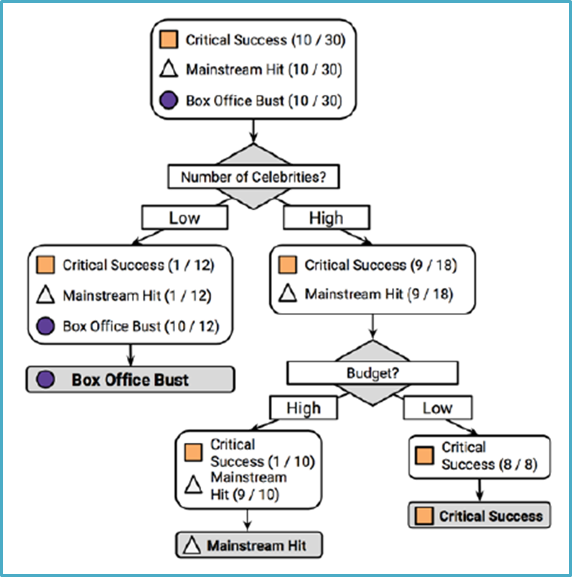
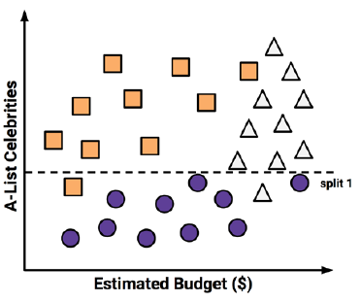
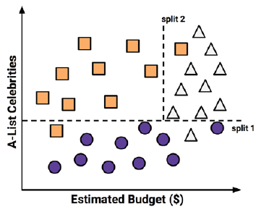
Classification using Decision trees

Slide 16
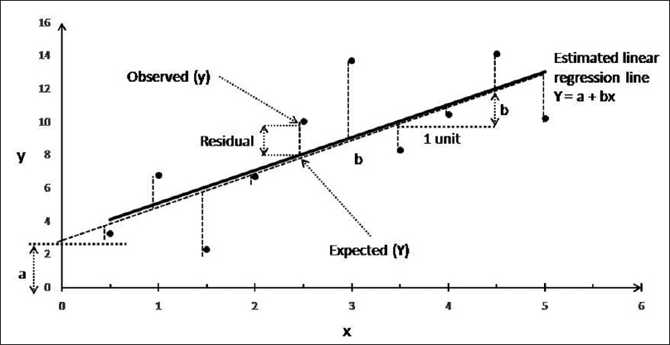

Linear Regression
Problem to Solve :
Target different brands of clothing (with different price bands) to different towns based on cost of living index :
Price band
Important points
Y – dependent variable
X – independent variable
a – value of y when x is 0 - “Intercept”
b – slope, increase in value of y per 1 unit increase in x - “Coefficient”
Regression line to fit Least sum of squares
e – residual error
Cost of living index
Multiple Linear Regression with intercept, coefficient and residual error

Slide 17
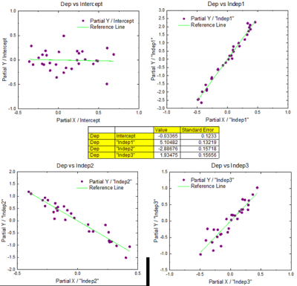
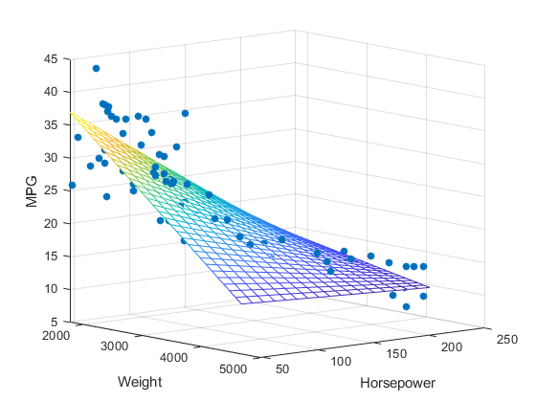
Linear regression

Slide 18
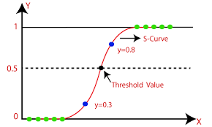

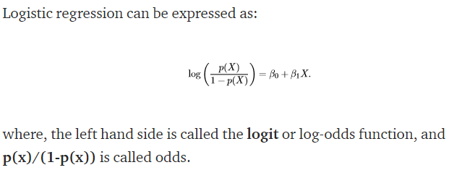
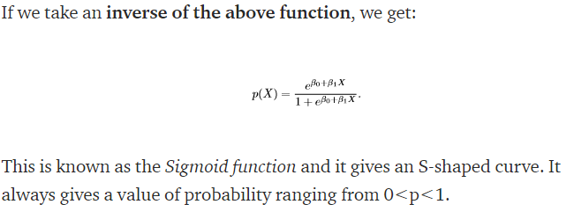
Logistic regression
It’s a classification algorithm, that is used where the response variable is categorical. The idea of Logistic Regression is to find a relationship between features and probability of particular outcome.
With binary classification, let ‘x’ be some feature and ‘y’ be the output which can be either 0 or 1.
The probability that the output is 1 given its input is used.
If we predict the probability via linear regression, we can state it as:
Linear regression model can generate the predicted probability as any number ranging from negative to positive infinity, whereas probability of an outcome can only lie between 0< P(x)<1.

Slide 19
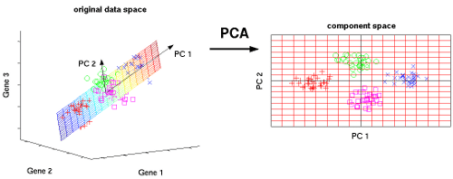
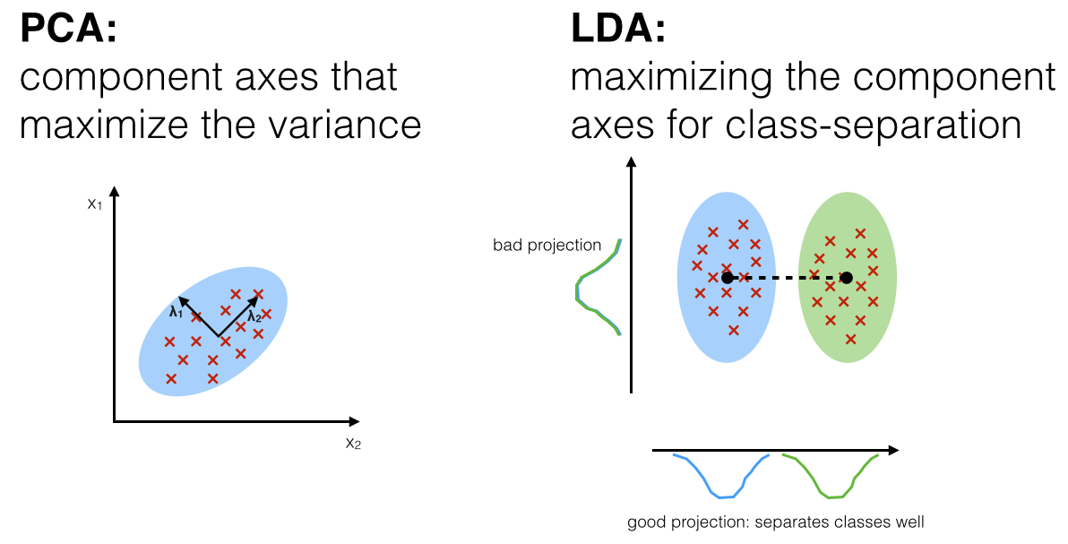
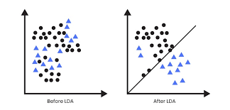
PCA and LDA

Slide 20
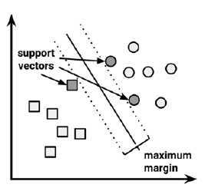
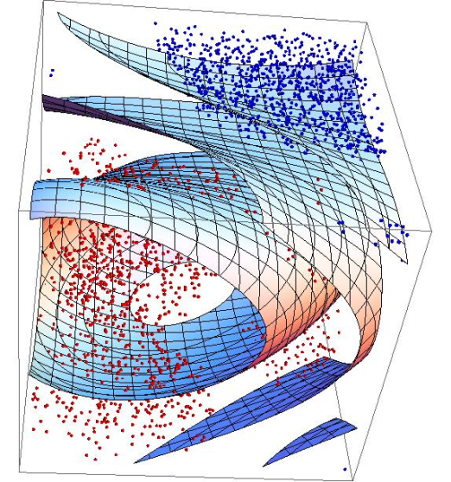
Support vector machines
Essentially, the kernel trick involves a process of constructing new features that express mathematical relationships between measured characteristics.

Slide 21
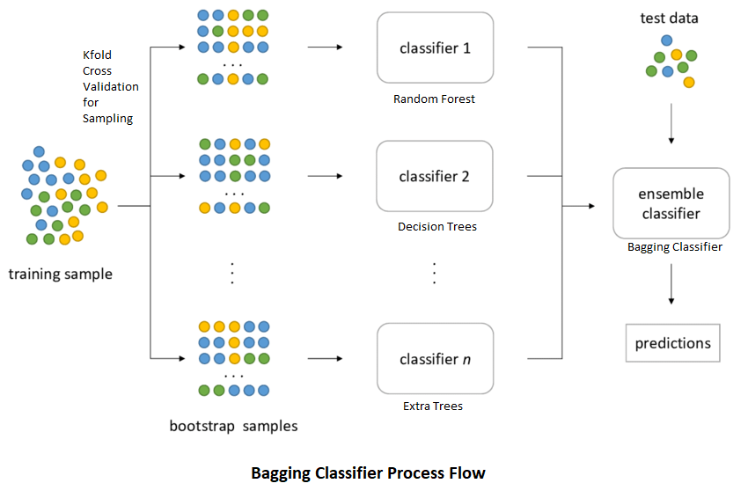
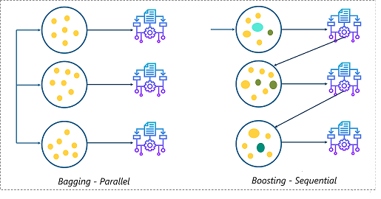
Ensemble methods

Slide 22
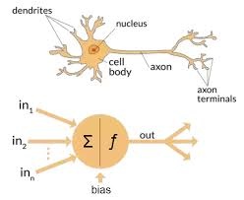
Artificial Neural Networks
They are modeled from nature
The field of artificial neural networks is often just called Neural Networks or Multilayer Perceptrons.
Neural networks with more than one hidden layer are Deep networks.
Adding more layers allows for more easy representation of the interactions within the input data, as well as allows for more abstract features to be learned and used as input into the next hidden layer.

Slide 23
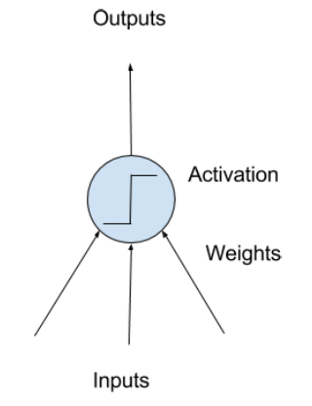
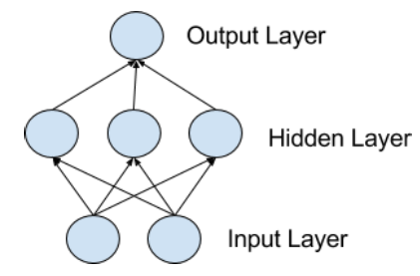
Artificial Neural Networks
Neuron
A simple Network

Slide 24
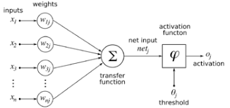
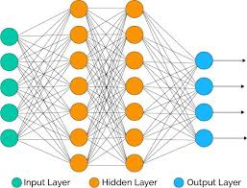

Artificial Neural Networks
Neuron - The building block for neural networks are artificial neurons.
Neuron Weights - They are similar to weights in Linear regression. Weights are often initialized to small random values
Types of Layers – Input, Hidden and Output

Slide 25
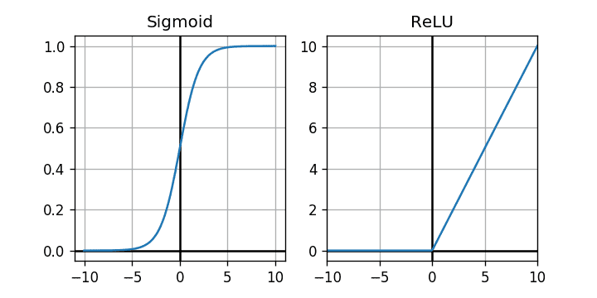
Artificial Neural Networks
Activation functions
A neural network without an activation function is essentially just a linear regression model.
An activation function is a simple mapping of summed weighted input to the output of the neuron.
Relu is the most popular functions for hidden layers.
Sigmoid for Binary and Softmax for multi-classification
Tanh is another function which can be used in any layer. It is similar to Sigmoid

Slide 26
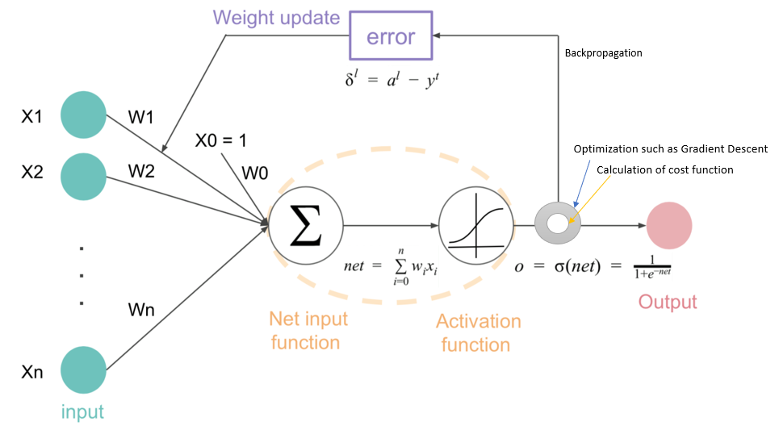
Artificial Neural Networks
Back-propagation is the most fundamental building block in a neural network.
The final step in a forward pass is to evaluate the predicted output against an expected output. It happens through a cost / loss function.
MSE (mean squared error) for Regression and cross-entropy for Classification problems (delta between actual and predicted probabilities)
Back-propagation aims to minimize the cost function by adjusting network’s weights and biases.

Slide 27
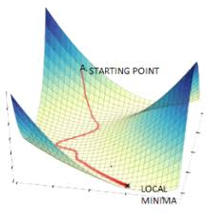
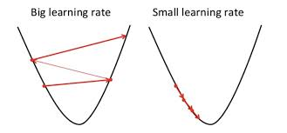
Artificial Neural Networks
Optimizers are algorithms or methods used to change the attributes of your neural network such as weights and learning rate in order to reduce the losses.
One of the most used algorithms for Optimizer functions is the Gradient Descent Algorithm.
The learning rate determines how big a step is taken in that direction.
A too high learning rate will make the learning jump over minima but a too low learning rate will either take too long to converge or get stuck in an undesirable local minimum.

Slide 28
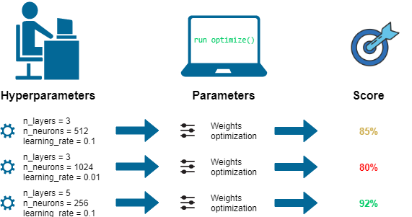
Artificial Neural Networks
Hyper-parameters are the levers we have to fine tune Neural networks
They include learning rate, number of layers, number of neurons in a given layer, Network Weight Initialization, Activation function, Number of epochs, Batch size etc.
We evaluate the performance of the network on a validation set, and then tweak the hyper-parameters and re-evaluate

Slide 29
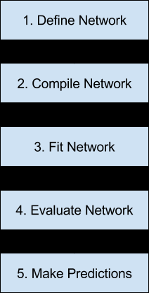
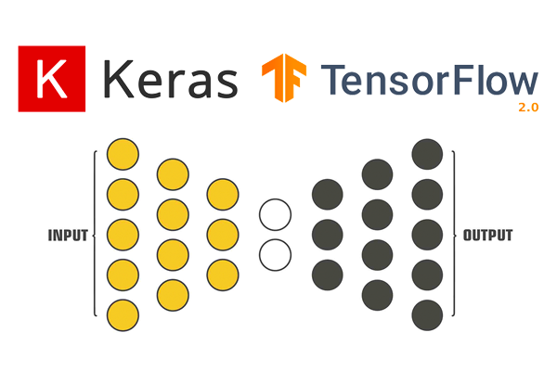
Artificial Neural Networks

Slide 30
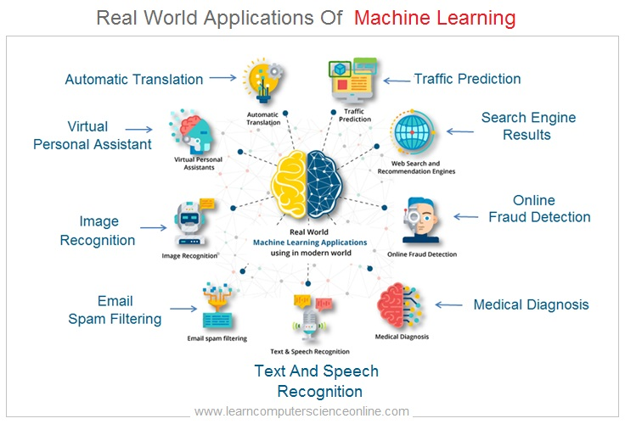
Industry use cases
https://www.analyticsvidhya.com/blog/2019/07/ultimate-list-popular-machine-learning-use-cases/
https://www.datarobot.com/use-cases/
https://jelvix.com/blog/machine-learning-use-cases

Slide 31
Thank You

